Slide 1
AUTOMATED STREET LIGHTING USING IOT
Team Members:
Dinesh lal
Abdul Hayyu
Sagar Roy

Slide 2
CONTENT
PROBLEM STATEMENT
ABSTRACT
BLOCK DIAGRAM
PROJECT CIRCUIT PICTURE
HARDWARE REQUIRED
SOFTWARE REQUIRED

Slide 3
PROBLEM STATEMENT
Automated street light based on light availability.
Use of ESP 8266 as a node.
Use of LDR (Light Dependent Resistor) as a Light Sensor.
Should be automated powering.

Slide 4
ABSTRACT
This project introduces you to the significance of IOT, and its fascinating applications. By doing this project you will develop an electronic device that uses LDR sensor to sense the sunlight intensity and send the data to the NodeMCU for interpretation.
The system can be programmed in a way that say whenever the sunlight intensity drops below a threshold value that you set, it will facilitate the switching ON/ OFF of the street light.
The data collected will be then sent to the cloud where it can be stored, analyzed and interpreted for better understanding of the power consumed.
This also facilitate the smart energy management to save lot of electricity.

Slide 5
BLOCK DIAGRAM
Light Dependent Sensor (LDR)
NodeMCU 1.0
PC
IBM Watson Cloud
Street Light as (LED)

Slide 6
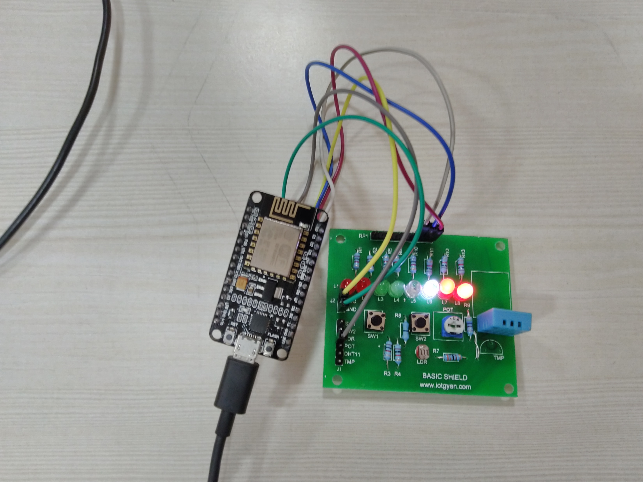
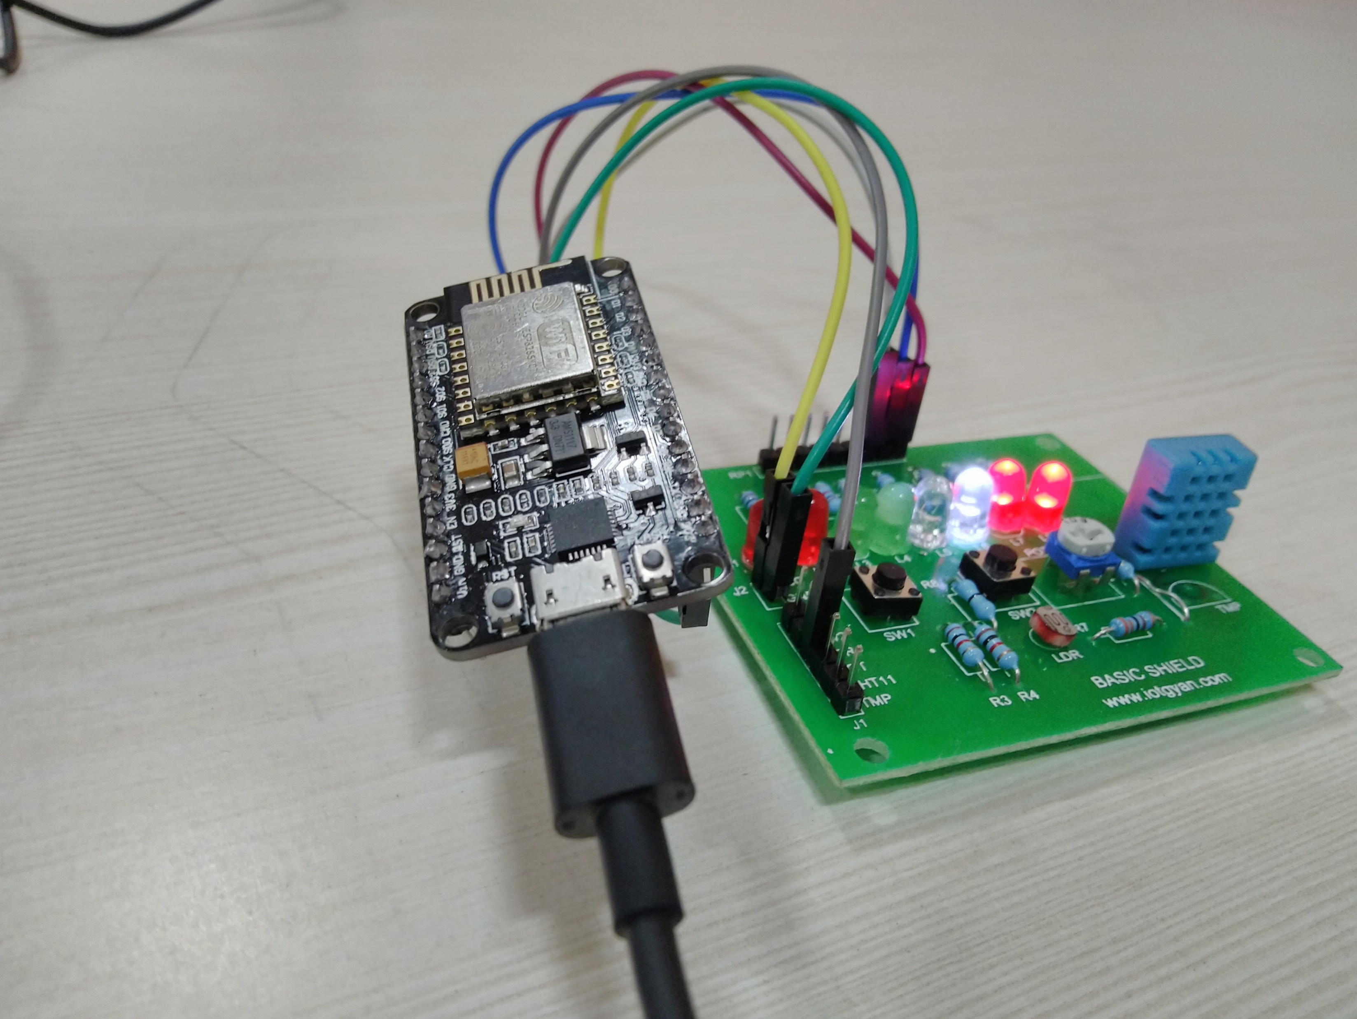
Project Circuit Picture

Slide 7
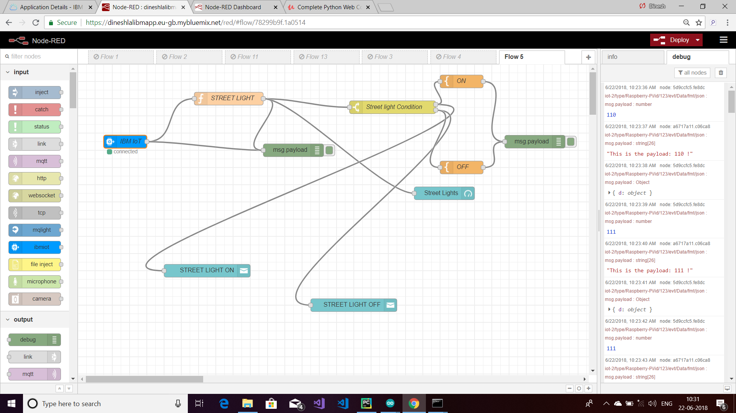

Slide 8
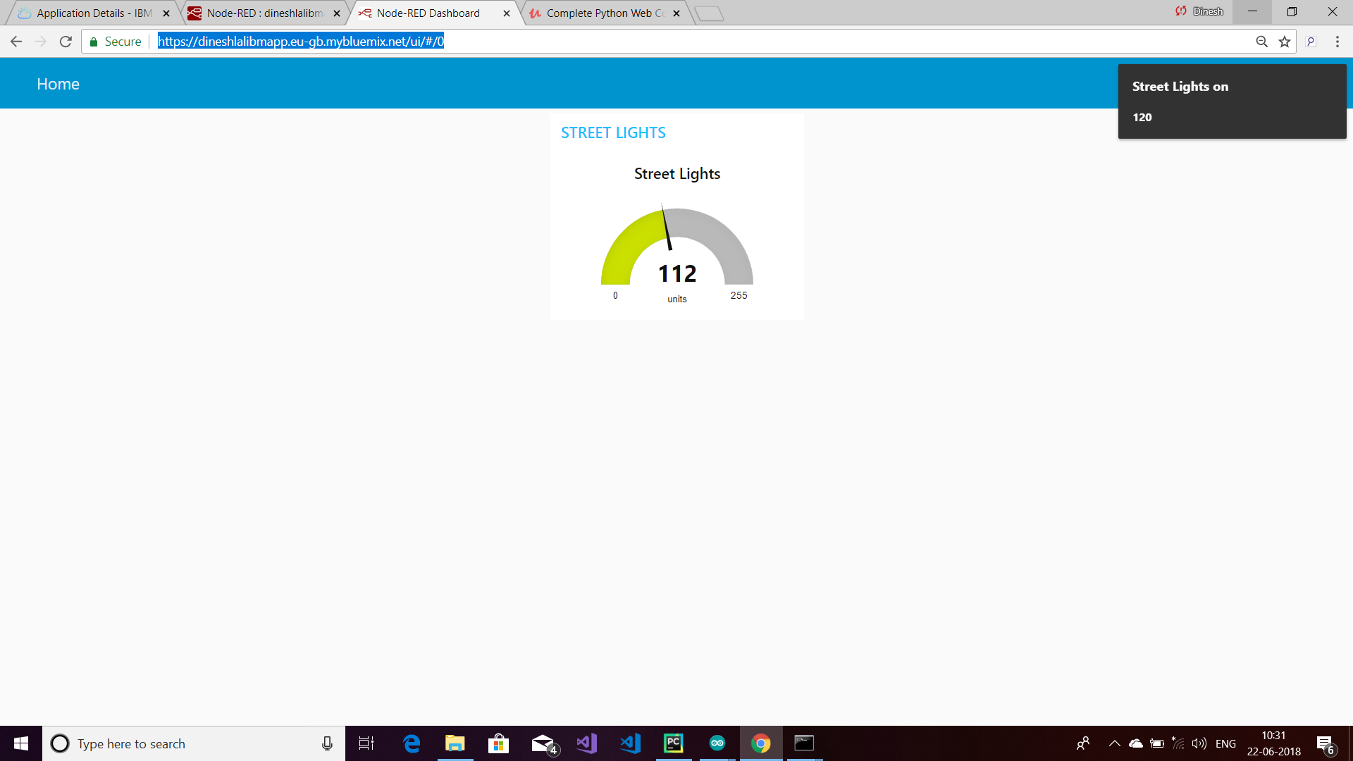

Slide 9
HARDWARE REQUIRED
Automated Street Light Project you will need 4 major hardware components,
LDR Sensor - It will detect the changes in the sunlight intensity and send the data to the Arduino for interpretation.
Relay Drivers - It will be used to convert the voltage that can be used to operate the street lights.
ESP 8266 Wi-Fi Module - This will be used to integrate the system onto cloud and facilitates storage & analysis of data collected.

Slide 10
SOFTWARE REQUIRED
Arduino IDE
NodeMCU 1.0 Library
IBM Cloud

